Slide 1
Minimum Spanning Tree

Slide 2
Problem: Laying Telephone Wire
Central office

Slide 3
Wiring: Naïve Approach
Central office
Expensive!

Slide 4
Wiring: Naive Approach
Central office
Minimize the total length of wire connecting the customers

Slide 5
Applications of MST
Telephone network
Electrical
TV cables
Road network
Provides a heuristic for traveling salesman problems.
The optimum traveling salesman tour is at most twice the length of the minimum spanning tree (why??)

Slide 6
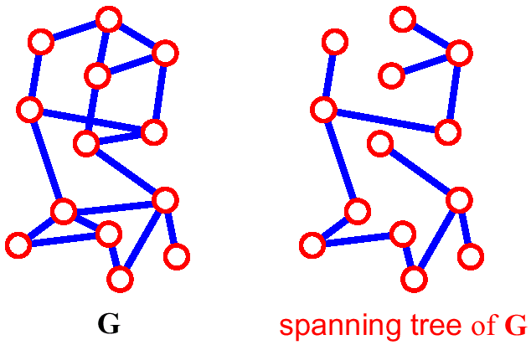
Spanning Tree
A spanning tree of G is a subgraph which
  is a tree
  contains all vertices of G
How many edges are there in a spanning tree, if there are V vertices?

Slide 7
Spanning Trees
A spanning tree of a graph is just a subgraph that contains all the vertices and is a tree.
A graph may have many spanning trees.
Graph A
Some Spanning Trees from Graph A
or
or
or

Slide 8
All 16 of its Spanning Trees
Complete Graph

Slide 9
Minimum Spanning Trees
The Minimum Spanning Tree for a given graph is the Spanning Tree of minimum cost for that graph.
Complete Graph
Minimum Spanning Tree
7
2
2
5
3
3
4
1
1

Slide 10
Generic MST Algorithm
Generic-MST(G, w)
1 A := ∅ // Contains edges that belong to a MST
2 while A does not form a spanning tree do
3 Find an edge (u,v) that is safe for A
4 A := A ∪ {(u,v)}
5 return A
A safe edge is an edge that does not destroy A’s property.
MoreSpecific-MST(G, w)
1 A := ∅ // Contains edges that belong to a MST
2 while A does not form a spanning tree do
3.1 Make a cut (S, V-S) of G that respects A
3.2 Take the min-weight edge (u,v) connecting S to V-S
4 A := A ∪ {(u,v)}
5 return A

Slide 11
MST
8
7
b
c
d
9
4
2
S↑
a
11
i
14
e
↑ S
4
7
6
8
10
V-S↓
h
g
f
↓ V-S
1
2
This figure shows a cut (S,V-S) of the graph.
The edge (d,c) is the unique light edge crossing the cut.

Slide 12
Idea for an Algorithm
We have to make V–1 choices (edges of the MST) to arrive at the optimization goal.
After each choice we have a sub-problem that is one vertex smaller than the original problem.
  A dynamic programming algorithm would consider all possible choices (edges) at each vertex.
  Goal: at each vertex cheaply determine an edge that definitely belongs to an MST.

Slide 13
Greedy Choice
Greedy choice property: locally optimal (greedy) choice yields a globally optimal solution.
Theorem on Greedy choice for MST
  Let G=(V, E) and S ⊆ V
  S is a cut of G (it splits G into parts S and V-S)
  (u,v) is a light edge if it is a min-weight edge of G that connects S and V-S
  Then (u,v) belongs to a MST T of G.

Slide 14
...Greedy Choice
Proof
  Suppose (u,v) is light but (u,v) ∉ any MST
  look at path from u to v in some MST T
  Let (x, y) be the first edge on a path from u to v in T that crosses from S to V–S. Swap (x, y) with (u,v) in T.
  this improves cost of T ➔ contradiction (T is supposed to be an MST)
V-S
S
y
x
u
v

Slide 15
Algorithms for Obtaining the Minimum Spanning Tree
Prim's Algorithm
Kruskal's Algorithm

Slide 16
Prim-Jarnik Algorithm
Vertex based algorithm
Grows a single MST T one vertex at a time
The set A covers the portion of T that was already computed
Annotate all vertices v outside of the set A with v.key the minimum weight of an edge that connects v to a vertex in A
(v.key = ∞ if no such edge exists)

Slide 17
The steps are:
1. The new graph is constructed - with one node from the old graph.
2. While new graph has fewer than n nodes,
  1. Find the node from the old graph with the smallest connecting edge to the new graph,
  2. Add it to the new graph
Every step will have joined one node, so that at the end we will have one graph with all the nodes and it will be a minimum spanning tree of the original graph.

Slide 18
Prim’s algorithm
T = a spanning tree containing a single node s;
E = set of edges adjacent to s;
while T does not contain all the nodes {
  remove an edge (v, w) of lowest cost from E
  if w is already in T then discard edge (v, w)
  else {
    add edge (v, w) and node w to T
    add to E the edges adjacent to w
  }
}
An edge of lowest cost can be found with a priority queue
Testing for a cycle is automatic
  Hence, Prim’s algorithm is far simpler to implement than Kruskal’s algorithm

Slide 19
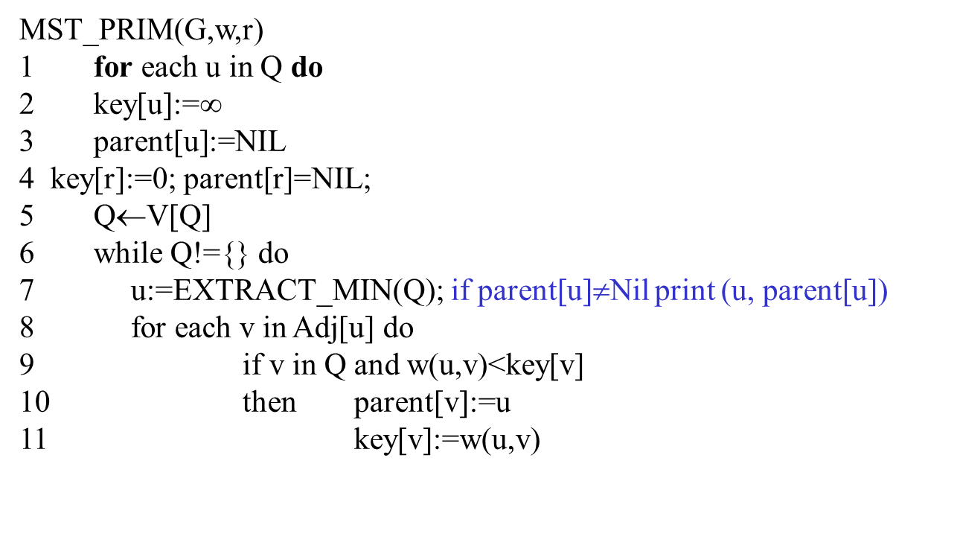
Prims’s Algorithm

Slide 20
Complete Graph
B
4
C
4
2
1
A
4
E
1
F
D
2
3
10
G
5
5
6
3
4
I
H
2
3
J

Slide 21
Old Graph
New Graph
B
4
C
4
B
4
C
2
1
4
2
1
A
4
E
1
F
A
4
E
F
1
D
2
3
10
D
2
3
G
5
10
G
5
5
6
3
5
6
3
4
I
4
H
I
3
H
2
J
2
3
J

Slide 22
Old Graph
New Graph
B
4
C
4
B
4
C
2
1
4
2
1
A
4
E
1
F
A
4
E
F
1
D
2
3
10
D
2
3
G
5
10
G
5
5
6
3
5
6
3
4
I
4
H
I
3
H
2
J
2
3
J

Slide 23
Old Graph
New Graph
B
4
C
4
B
4
C
2
1
4
2
1
A
4
E
1
F
A
4
E
F
1
D
2
3
10
D
2
3
G
5
10
G
5
5
6
3
5
6
3
4
I
4
H
I
3
H
2
J
2
3
J

Slide 24
Old Graph
New Graph
B
4
C
4
B
4
C
2
1
4
2
1
A
4
E
1
F
A
4
E
F
1
D
2
3
10
D
2
3
G
5
10
G
5
5
6
3
5
6
3
4
I
4
H
I
3
H
2
J
2
3
J

Slide 25
Old Graph
New Graph
B
4
C
4
B
4
C
2
1
4
2
1
A
4
E
1
F
A
4
E
F
1
D
2
3
10
D
2
3
G
5
10
G
5
5
6
3
5
6
3
4
I
4
H
I
3
H
2
J
2
3
J

Slide 26
Old Graph
New Graph
B
4
C
4
B
4
C
2
1
4
2
1
A
4
E
1
F
A
4
E
F
1
D
2
3
10
D
2
3
G
5
10
G
5
5
6
3
5
6
3
4
I
4
H
I
3
H
2
J
2
3
J

Slide 27
Old Graph
New Graph
B
4
C
4
B
4
C
2
1
4
2
1
A
4
E
1
F
A
4
E
F
1
D
2
3
10
D
2
3
G
5
10
G
5
5
6
3
5
6
3
4
I
4
H
I
3
H
2
J
2
3
J

Slide 28
Old Graph
New Graph
B
4
C
4
B
4
C
2
1
4
2
1
A
4
E
1
F
A
4
E
F
1
D
2
3
10
D
2
3
G
5
10
G
5
5
6
3
5
6
3
4
I
4
H
I
3
H
2
J
2
3
J

Slide 29
Old Graph
New Graph
B
4
C
4
B
4
C
2
1
4
2
1
A
4
E
1
F
A
4
E
F
1
D
2
3
10
D
2
3
G
5
10
G
5
5
6
3
5
6
3
4
I
4
H
I
3
H
2
J
2
3
J

Slide 30
Old Graph
New Graph
B
4
C
4
B
4
C
2
1
4
2
1
A
4
E
1
F
A
4
E
F
1
D
2
3
10
D
2
3
G
5
10
G
5
5
6
3
5
6
3
4
I
4
H
I
3
H
2
J
2
3
J

Slide 31
Complete Graph
Minimum Spanning Tree
B
4
C
4
B
4
C
2
1
4
2
1
A
4
E
1
F
A
E
F
1
D
2
3
10
D
2
G
5
G
5
6
3
3
4
I
H
I
3
H
2
J
2
3
J

Slide 32
Walk-Through
MST-Prim(G,r)
01 for each vertex u ∈ G.V
02 u.key := ∞
03 u.parent := NIL
04 r.key := 0
05 init(Q, G.V) // Q is a priority queue
06 while not isEmpty(Q)
07 u := extractMin(Q) // add u to T
08 for each v ∈ u.adj do
09 if v ∈ Q and w(u,v) < v.key then
v.key := w(u,v)
11 modifyKey(Q,v)
12 v.parent := u
Initialize array
 | K | d_{v} | p_{v}
A | F | ∞ | −
B | F | ∞ | −
C | F | ∞ | −
D | F | ∞ | −
E | F | ∞ | −
F | F | ∞ | −
G | F | ∞ | −
H | F | ∞ | −

Slide 33
Start with any node, say D
2
F
3
C
 | K | d_{v} | p_{v}
A
B
C
D | T | 0 | −
E
F
G
H
10
A
7
3
8
4
4
B
18
D
9
10
H
2
25
3
G
E
7

Slide 34
Update distances of adjacent, unselected nodes
2
F
3
C
 | K | d_{v} | p_{v}
A
B
C |  | 3 | D
D | T | 0 | −
E |  | 25 | D
F |  | 18 | D
G |  | 2 | D
H
10
A
7
3
8
4
4
B
18
D
9
10
H
2
25
3
G
E
7

Slide 35
2
Select node with minimum distance
F
3
C
 | K | d_{v} | p_{v}
A
B
C |  | 3 | D
D | T | 0 | −
E |  | 25 | D
F |  | 18 | D
G | T | 2 | D
H
10
A
7
3
8
4
4
B
18
D
9
10
H
2
25
3
G
E
7

Slide 36
Update distances of adjacent, unselected nodes
2
F
3
C
 | K | d_{v} | p_{v}
A
B
C |  | 3 | D
D | T | 0 | −
E |  | 7 | G
F |  | 18 | D
G | T | 2 | D
H |  | 3 | G
10
A
7
3
8
4
4
B
18
D
9
10
H
2
25
3
G
E
7

Slide 37
Select node with minimum distance
2
F
3
C
 | K | d_{v} | p_{v}
A
B
C | T | 3 | D
D | T | 0 | −
E |  | 7 | G
F |  | 18 | D
G | T | 2 | D
H |  | 3 | G
10
A
7
3
8
4
4
B
18
D
9
10
H
2
25
3
G
E
7

Slide 38
Update distances of adjacent, unselected nodes
2
F
3
C
 | K | d_{v} | p_{v}
A
B |  | 4 | C
C | T | 3 | D
D | T | 0 | −
E |  | 7 | G
F |  | 3 | C
G | T | 2 | D
H |  | 3 | G
10
A
7
3
8
4
4
B
18
D
9
10
H
2
25
3
G
E
7

Slide 39
Select node with minimum distance
2
F
3
C
 | K | d_{v} | p_{v}
A
B |  | 4 | C
C | T | 3 | D
D | T | 0 | −
E |  | 7 | G
F | T | 3 | C
G | T | 2 | D
H |  | 3 | G
10
A
7
3
8
4
4
B
18
D
9
10
H
2
25
3
G
E
7

Slide 40
Update distances of adjacent, unselected nodes
2
F
3
C
 | K | d_{v} | p_{v}
A |  | 10 | F
B |  | 4 | C
C | T | 3 | D
D | T | 0 | −
E |  | 2 | F
F | T | 3 | C
G | T | 2 | D
H |  | 3 | G
10
A
7
3
8
4
4
B
18
D
9
10
H
2
25
3
G
E
7

Slide 41
2
Select node with minimum distance
F
3
C
 | K | d_{v} | p_{v}
A |  | 10 | F
B |  | 4 | C
C | T | 3 | D
D | T | 0 | −
E | T | 2 | F
F | T | 3 | C
G | T | 2 | D
H |  | 3 | G
10
A
7
3
8
4
4
B
18
D
9
10
H
2
25
3
G
E
7

Slide 42
Update distances of adjacent, unselected nodes
2
F
3
C
 | K | d_{v} | p_{v}
A |  | 10 | F
B |  | 4 | C
C | T | 3 | D
D | T | 0 | −
E | T | 2 | F
F | T | 3 | C
G | T | 2 | D
H |  | 3 | G
10
A
7
3
8
4
4
B
18
D
9
10
H
2
25
3
G
E
7
Table entries unchanged

Slide 43
Select node with minimum distance
2
F
3
C
 | K | d_{v} | p_{v}
A |  | 10 | F
B |  | 4 | C
C | T | 3 | D
D | T | 0 | −
E | T | 2 | F
F | T | 3 | C
G | T | 2 | D
H | T | 3 | G
10
A
7
3
8
4
4
B
18
D
9
10
H
2
25
3
G
E
7

Slide 44
Update distances of adjacent, unselected nodes
2
F
3
C
 | K | d_{v} | p_{v}
A |  | 4 | H
B |  | 4 | C
C | T | 3 | D
D | T | 0 | −
E | T | 2 | F
F | T | 3 | C
G | T | 2 | D
H | T | 3 | G
10
A
7
3
8
4
4
B
18
D
9
10
H
2
25
3
G
E
7

Slide 45
Select node with minimum distance
2
F
3
C
 | K | d_{v} | p_{v}
A | T | 4 | H
B |  | 4 | C
C | T | 3 | D
D | T | 0 | −
E | T | 2 | F
F | T | 3 | C
G | T | 2 | D
H | T | 3 | G
10
A
7
3
8
4
4
B
18
D
9
10
H
2
25
3
G
E
7

Slide 46
Update distances of adjacent, unselected nodes
2
F
3
C
 | K | d_{v} | p_{v}
A | T | 4 | H
B |  | 4 | C
C | T | 3 | D
D | T | 0 | −
E | T | 2 | F
F | T | 3 | C
G | T | 2 | D
H | T | 3 | G
10
A
7
3
8
4
4
B
18
D
9
10
H
2
25
3
G
E
7
Table entries unchanged

Slide 47
Select node with minimum distance
2
F
3
C
 | K | d_{v} | p_{v}
A | T | 4 | H
B | T | 4 | C
C | T | 3 | D
D | T | 0 | −
E | T | 2 | F
F | T | 3 | C
G | T | 2 | D
H | T | 3 | G
10
A
7
3
8
4
4
B
18
D
9
10
H
2
25
3
G
E
7

Slide 48
Cost of Minimum Spanning Tree = Σ d_{v} = 21
2
F
3
C
 | K | d_{v} | p_{v}
A | T | 4 | H
B | T | 4 | C
C | T | 3 | D
D | T | 0 | −
E | T | 2 | F
F | T | 3 | C
G | T | 2 | D
H | T | 3 | G
A
3
4
4
B
D
H
2
3
G
E
Done

Slide 49
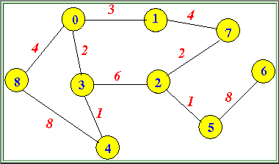
MST Exercise
B
5
C
3
6
4
8
8
A
F
D
7
5
4
2
E

Slide 50
Kruskal's Algorithm

Slide 51
Kruskal's Algorithm
Edge based algorithm
Add edges one at a time in increasing weight order.
The algorithm maintains A: a forest of trees.
An edge is accepted if it connects vertices of distinct trees (the cut respects A)

Slide 52
The steps are:
1. The forest is constructed - with each node in a separate tree.
2. The edges are placed in a priority queue.
3. Until we've added n-1 edges,
1. Extract the cheapest edge from the queue,
2. If it forms a cycle, reject it,
3. Else add it to the forest. Adding it to the forest will join two trees together.
Every step will have joined two trees in the forest together, so that at the end, there will only be one tree in T.

Slide 53
Kruskal’s algorithm
Finding an edge of lowest cost can be done just by sorting the edges.
Efficient testing for a cycle requires a fairly complex algorithm (UNION-FIND) which we don’t cover in this course
T = empty spanning tree;
E = set of edges;
N = number of nodes in graph;
while T has fewer than N - 1 edges {
  remove an edge (v, w) of lowest cost from E
  if adding (v, w) to T would create a cycle
    then discard (v, w)
    else add (v, w) to T
}

Slide 54
Kruskal's Algorithm
The algorithm keeps adding the cheapest edge that connects two trees of the forest
MST_KRUSKAL(G,w)
1 A:={}
2 for each vertex v in V[G]
3 do MAKE_SET(v)
4 Sort the edges of E by nondecreasing weight w
5 for each edge (u,v) in E, in order by nondecreasing weight
6 do if FIND_SET(u) != FIND_SET(v)
7 then A:=A∪{(u,v)}
8 UNION(u,v)
9 return A

Slide 55
Complete Graph
B
4
C
4
2
1
A
4
E
1
F
D
2
3
10
G
5
5
6
3
4
I
H
2
3
J

Slide 56
A
4
B
A
1
D
B
4
C
B
4
D
B
4
C
B
10
J
C
2
E
4
2
1
C
1
F
D
5
H
A
4
E
1
F
2
D
6
J
E
2
G
D
3
10
G
5
F
3
G
F
5
I
5
6
3
4
I
G
3
I
G
4
J
H
2
3
J
H
2
J
I
3
J

Slide 57
Sort Edges
(in reality they are placed in a priority queue - not sorted - but sorting them makes the algorithm easier to visualize)
1
1
A
D
C
F
C
2
E
E
2
G
B
4
C
H
2
J
F
3
G
4
2
1
G
3
I
I
3
J
A
4
E
1
F
2
A
4
B
B
4
D
D
3
10
G
5
B
4
C
G
4
J
5
6
3
4
I
F
5
I
D
5
H
H
2
3
J
D
6
J
B
10
J

Slide 58
Add Edge
1
1
A
D
C
F
C
2
E
E
2
G
B
4
C
H
2
J
F
3
G
4
2
1
G
3
I
I
3
J
A
4
E
1
F
2
A
4
B
B
4
D
D
3
10
G
5
B
4
C
G
4
J
5
6
3
4
I
F
5
I
D
5
H
H
2
3
J
D
6
J
B
10
J

Slide 59
Add Edge
1
1
A
D
C
F
C
2
E
E
2
G
B
4
C
H
2
J
F
3
G
4
2
1
G
3
I
I
3
J
A
4
E
1
F
2
A
4
B
B
4
D
D
3
10
G
5
B
4
C
G
4
J
5
6
3
4
I
F
5
I
D
5
H
H
2
3
J
D
6
J
B
10
J

Slide 60
Add Edge
1
1
A
D
C
F
C
2
E
E
2
G
B
4
C
H
2
J
F
3
G
4
2
1
G
3
I
I
3
J
A
4
E
1
F
2
A
4
B
B
4
D
D
3
10
G
5
B
4
C
G
4
J
5
6
3
4
I
F
5
I
D
5
H
H
2
3
J
D
6
J
B
10
J

Slide 61
Add Edge
1
1
A
D
C
F
C
2
E
E
2
G
B
4
C
H
2
J
F
3
G
4
2
1
G
3
I
I
3
J
A
4
E
1
F
2
A
4
B
B
4
D
D
3
10
G
5
B
4
C
G
4
J
5
6
3
4
I
F
5
I
D
5
H
H
2
3
J
D
6
J
B
10
J

Slide 62
Add Edge
1
1
A
D
C
F
C
2
E
E
2
G
B
4
C
H
2
J
F
3
G
4
2
1
G
3
I
I
3
J
A
4
E
1
F
2
A
4
B
B
4
D
D
3
10
G
5
B
4
C
G
4
J
5
6
3
4
I
F
5
I
D
5
H
H
2
3
J
D
6
J
B
10
J

Slide 63
Cycle
Don’t Add Edge
1
1
A
D
C
F
C
2
E
E
2
G
B
4
C
H
2
J
F
3
G
4
2
1
G
3
I
I
3
J
A
4
E
1
F
2
A
4
B
B
4
D
D
3
10
G
5
B
4
C
G
4
J
5
6
3
4
I
F
5
I
D
5
H
H
2
3
J
D
6
J
B
10
J

Slide 64
Add Edge
1
1
A
D
C
F
C
2
E
E
2
G
B
4
C
H
2
J
F
3
G
4
2
1
G
3
I
I
3
J
A
4
E
1
F
2
A
4
B
B
4
D
D
3
10
G
5
B
4
C
G
4
J
5
6
3
4
I
F
5
I
D
5
H
H
2
3
J
D
6
J
B
10
J

Slide 65
Add Edge
1
1
A
D
C
F
C
2
E
E
2
G
B
4
C
H
2
J
F
3
G
4
2
1
G
3
I
I
3
J
A
4
E
1
F
2
A
4
B
B
4
D
D
3
10
G
5
B
4
C
G
4
J
5
6
3
4
I
F
5
I
D
5
H
H
2
3
J
D
6
J
B
10
J

Slide 66
Add Edge
1
1
A
D
C
F
C
2
E
E
2
G
B
4
C
H
2
J
F
3
G
4
2
1
G
3
I
I
3
J
A
4
E
1
F
2
A
4
B
B
4
D
D
3
10
G
5
B
4
C
G
4
J
5
6
3
4
I
F
5
I
D
5
H
H
2
3
J
D
6
J
B
10
J

Slide 67
Cycle
Don’t Add Edge
1
1
A
D
C
F
C
2
E
E
2
G
B
4
C
H
2
J
F
3
G
4
2
1
G
3
I
I
3
J
A
4
E
1
F
2
A
4
B
B
4
D
D
3
10
G
5
B
4
C
G
4
J
5
6
3
4
I
F
5
I
D
5
H
H
2
3
J
D
6
J
B
10
J

Slide 68
Add Edge
1
1
A
D
C
F
C
2
E
E
2
G
B
4
C
H
2
J
F
3
G
4
2
1
G
3
I
I
3
J
A
4
E
1
F
2
A
4
B
B
4
D
D
3
10
G
5
B
4
C
G
4
J
5
6
3
4
I
F
5
I
D
5
H
H
2
3
J
D
6
J
B
10
J

Slide 69
Minimum Spanning Tree
Complete Graph
B
4
C
4
B
C
4
4
2
1
2
1
A
E
A
4
1
F
E
F
1
D
2
2
D
3
10
G
G
5
3
5
6
3
4
I
I
H
H
2
3
3
J
2
J

Slide 70
Walk Through
8
6
D
B
C
4
A
3
4
13
9
12
6
I
8
H
10
5
F
E
3
1
G
S = { A, B, C, D, E, F, G, H, I }
E’ = { HG-1, CI-3, GF-3, CF-4, AB-4, HI-6, CD-6, BC-8, AH-8, DE-9, EF-10, BH-12, DF-13 }
S = { A, B, C, D, E, F, G, H, I }
E’ = { HG-1, CI-3, GF-3, CF-4, AB-4, HI-6, CD-6, BC-8, AH-8, DE-9, EF-10, BH-12, DF-13 }

Slide 71
Walk Through
8
6
D
B
C
4
A
3
4
13
9
12
6
I
8
H
10
5
F
E
3
1
G
S = { A, B, C, D, E, F, GH, I }
E’ = { CI-3, GF-3, CF-4, AB-4, HI-6, CD-6, BC-8, AH-8, DE-9, EF-10, BH-12, DF-13 }

Slide 72
Walk Through
8
6
D
B
C
4
A
3
4
13
9
12
6
I
8
H
10
5
F
E
3
1
G
S = { A, B, CI, D, E, F, GH }
E’ = { GF-3, CF-4, AB-4, HI-6, CD-6, BC-8, AH-8, DE-9, EF-10, BH-12, DF-13 }

Slide 73
Walk Through
8
6
D
B
C
4
A
3
4
13
9
12
6
I
8
H
10
5
F
E
3
1
G
S = { A, B, CI, D, E, FGH }
E’ = { CF-4, AB-4, HI-6, CD-6, BC-8, AH-8, DE-9, EF-10, BH-12, DF-13 }

Slide 74
Walk Through
8
6
D
B
C
4
A
3
4
13
9
12
6
I
8
H
10
5
F
E
3
1
G
S = { A, B, CFGHI, D, E }
E’ = { AB-4, HI-6, CD-6, BC-8, AH-8, DE-9, EF-10, BH-12, DF-13 }

Slide 75
Walk Through
8
6
D
B
C
4
A
3
4
13
9
12
6
I
8
H
10
5
F
E
3
1
G
S = { AB, CFGHI, D, E }
E’ = { HI-6, CD-6, BC-8, AH-8, DE-9, EF-10, BH-12, DF-13 }

Slide 76
Walk Through
8
6
D
B
C
4
A
3
4
13
9
12
6
I
8
H
10
5
F
E
3
1
G
S = { AB, CDFGHI, E }
E’ = { BC-8, AH-8, DE-9, EF-10, BH-12, DF-13 }

Slide 77
Walk Through
8
6
D
B
C
4
A
3
4
13
9
12
6
I
8
H
10
5
F
E
3
1
G
S = { ABCDFGHI, E }
E’ = { AH-8, DE-9, EF-10, BH-12, DF-13 }

Slide 78
Walk Through
8
6
D
B
C
4
A
3
4
13
9
12
6
I
8
H
10
5
F
E
3
1
G
S = { ABCDEFGHI }
E’ = { EF-10, BH-12, DF-13 }

Slide 79
Walk Through
8
6
D
B
C
4
A
3
4
9
I
H
E
3
F
1
G
S = { ABCDEFGHI }
E’ = { HG-1, CI-3, GF-3, CF-4, AB-4, CD-6, BC-8, DE-9 }; Total Cost := 38

Slide 80
Implementation Factors: Disjoint Sets
We need to maintain a disjoint partitioning of a set, i.e., a collection S of disjoint sets. Operations:
  addSingeltonSet(S:Set, x:Vertex)
    S := S ∪ {{x}}
  findSet(S:Set, x:Vertex): Set
    returns X ∈ S such that x ∈ X
  unionSets(S:Set, x:Vertex, y:Vertex)
    X := findSet(S:Set, x)
    Y := findSet(S:Set, y)
    S := S – {X, Y} ∪ {X ∪ Y}

Slide 81
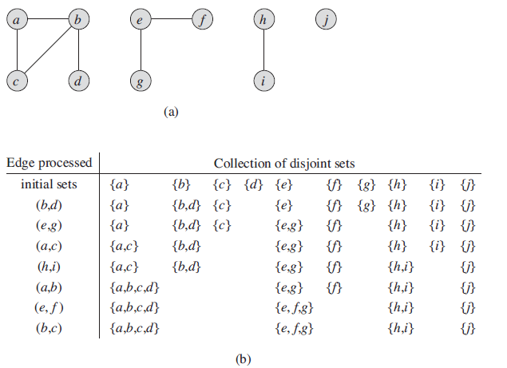
Disjoint Sets

Slide 82
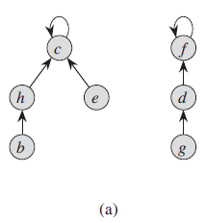
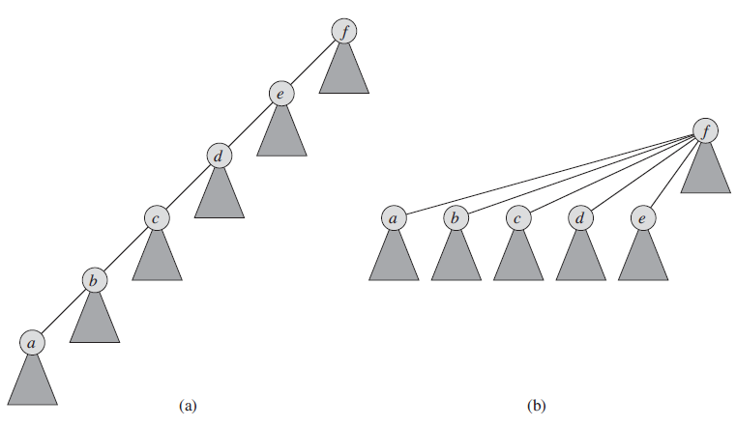
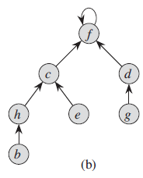
Disjoint-set forests

Slide 83
Implementation Factors: Disjoint Sets as Lists
Each set is a list of elements identified by the first element, all elements in the list point to the first element
UnionSets: add a shorter list to a longer one, O(min{|C(u)|, |C(v)|})
MakeSet/FindSet: O(1)
1
2
3
4
A
B
C
∅
∅
1
2
3
4
A
B
C
∅

Slide 84
Kruskal Running Time
Initialization O(V) time
Sorting the edges Θ(E log E) = Θ(E log V)
O(E) calls to FindSet
Union costs
  Let t(v) be the number of times v is moved to a new cluster
  Each time a vertex is moved to a new cluster the size of the cluster containing the vertex at least doubles: t(v) ≤ log V
  Total time spent doing Union
Total time: O(E log V)

Slide 85
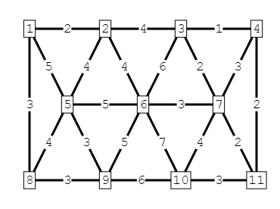
MST Exercise
B
5
C
3
4
8
6
8
A
F
D
7
5
4
2
E

Slide 86
Boruvka's Algorithm
This algorithm is similar to Prim’s, but nodes are added to the new graph in parallel all around the graph.
It creates a list of trees, each containing one node from the original graph and proceeds to merge them along the smallest-weight connecting edges until there’s only one tree, which is, of course, the MST.
It works rather like a merge sort.

Slide 87
The steps are
1. Make a list of n trees, each containing a single node
2. While list has more than one tree,
1. For each tree in the list, find the node not connected to the tree with the smallest connecting edge to that tree,
2. Add all the edges found to the new graph, thus creating a new set of trees
Every step will have joined groups of trees, until only one tree remains.

Slide 88
Complete Graph
B
4
C
4
2
1
A
4
E
1
F
D
2
3
10
G
5
5
6
3
4
I
H
2
3
J

Slide 89
Boruvka's Example
List of Trees
Trees of the Graph at Beginning of Round 1
4
A
B
C
D
E
F
G
H
I
J
B
C
4
2
1
A
4
E
1
F
D
2
3
10
G
5
5
6
3
4
I
H
2
3
J

Slide 90
Round 1
Tree A
B
4
C
B
4
4
2
1
A
4
E
A
1
F
1
D
2
3
D
10
G
5
5
6
3
4
I
H
2
3
J

Slide 91
Round 1
Edge A-D
B
4
C
B
4
4
2
1
A
4
E
A
1
F
1
D
2
3
D
10
G
5
5
6
3
4
I
H
2
3
J

Slide 92
Round 1
Tree B
B
4
C
4
B
C
4
4
2
1
A
4
E
A
4
1
F
D
2
3
D
10
10
G
5
5
6
3
4
I
H
2
3
J
J

Slide 93
Round 1
Edge B-A
B
4
C
4
B
C
4
4
2
1
A
4
E
A
4
1
F
D
2
3
D
10
10
G
5
5
6
3
4
I
H
2
3
J
J

Slide 94
Round 1
Tree C
B
4
C
4
B
C
4
2
1
2
1
A
4
E
1
F
E
F
D
2
3
10
G
5
5
6
3
4
I
H
2
3
J

Slide 95
Round 1
Edge C-F
B
4
C
4
B
C
4
2
1
2
1
A
4
E
1
F
E
F
D
2
3
10
G
5
5
6
3
4
I
H
2
3
J

Slide 96
Round 1
Tree D
B
4
C
B
4
2
1
A
4
E
A
4
1
F
1
D
2
3
D
10
G
5
5
6
3
5
6
4
I
H
H
2
3
J
J

Slide 97
Round 1
Edge D-A
B
4
C
B
4
2
1
A
4
E
A
4
1
F
1
D
2
3
D
10
G
5
5
6
3
5
6
4
I
H
H
2
3
J
J

Slide 98
Round 1
Tree E
B
4
C
C
4
2
1
2
A
4
E
1
F
E
D
2
3
2
10
G
5
G
5
6
3
4
I
H
2
3
J

Slide 99
Round 1
Edge E-C
B
4
C
C
4
2
1
2
A
4
E
1
F
E
D
2
3
2
10
G
5
G
5
6
3
4
I
H
2
3
J

Slide 100
Round 1
Tree F
B
4
C
C
4
2
1
1
A
4
E
1
F
F
D
2
3
3
10
G
5
5
G
5
6
3
4
I
I
H
2
3
J

Slide 101
Round 1
Edge F-C
B
4
C
C
4
2
1
1
A
4
E
1
F
F
D
2
3
3
10
G
5
5
G
5
6
3
4
I
I
H
2
3
J

Slide 102
Round 1
Tree G
B
4
C
4
2
1
A
4
E
1
F
E
F
D
2
3
2
3
10
G
5
G
5
6
3
3
4
4
I
I
H
2
3
J
J

Slide 103
Round 1
Edge G-E
B
4
C
4
2
1
A
4
E
1
F
E
F
D
2
3
2
3
10
G
5
G
5
6
3
3
4
4
I
I
H
2
3
J
J

Slide 104
Round 1
Tree H
B
4
C
4
2
1
A
4
E
1
F
D
2
3
D
10
G
5
5
6
3
5
4
I
H
H
2
3
J
2
J

Slide 105
Round 1
Edge H-J
B
4
C
4
2
1
A
4
E
1
F
D
2
3
D
10
G
5
5
6
3
5
4
I
H
H
2
3
J
2
J

Slide 106
Round 1
Tree I
B
4
C
4
2
1
A
4
E
1
F
F
D
2
3
10
G
5
5
G
5
6
3
3
4
I
I
H
2
3
3
J
J

Slide 107
Round 1
Edge I-G
B
4
C
4
2
1
A
4
E
1
F
F
D
2
3
10
G
5
5
G
5
6
3
3
4
I
I
H
2
3
3
J
J

Slide 108
Round 1
Tree J
B
4
C
B
4
2
1
A
4
E
1
F
D
2
3
D
10
10
G
5
G
5
6
3
6
4
4
I
I
H
H
2
3
3
J
2
J

Slide 109
Round 1
Edge J-H
B
4
C
B
4
2
1
A
4
E
1
F
D
2
3
D
10
10
G
5
G
5
6
3
6
4
4
I
I
H
H
2
3
3
J
2
J

Slide 110
Round 1 Ends - Add Edges
List of Edges to Add
4
A-D
B-A
C-F
D-A
E-C
F-C
G-E
H-J
I-G
J-H
B
C
4
2
1
A
4
E
1
F
D
2
3
10
G
5
5
6
3
4
I
H
2
3
J

Slide 111
Trees of the Graph at Beginning of Round 2
List of Trees
4
D-A-B
F-C-E-G-I
H-J
B
C
4
2
1
A
4
E
1
F
D
2
3
10
G
5
5
6
3
4
I
H
2
3
J

Slide 112
Round 2
Tree D-A-B
B
4
C
4
B
C
4
4
2
1
2
1
A
4
E
A
4
1
F
E
F
1
D
2
3
2
D
10
10
G
5
G
5
6
3
5
6
3
4
I
I
H
H
2
3
J
2
J

Slide 113
Round 2
Edge B-C
B
4
C
4
B
C
4
4
2
1
2
1
A
4
E
A
4
1
F
E
F
1
D
2
3
2
D
10
10
G
5
G
5
6
3
5
6
3
4
I
I
H
H
2
3
J
2
J

Slide 114
Round 2
Tree F-C-E-G-I
B
4
C
4
B
C
4
4
2
1
2
1
A
4
E
A
1
F
E
F
1
D
2
3
2
D
3
10
G
5
5
G
5
6
3
3
4
4
I
I
H
H
2
3
3
J
2
J

Slide 115
Round 2
Edge I-J
B
4
C
4
B
C
4
4
2
1
2
1
A
4
E
A
1
F
E
F
1
D
2
3
2
D
3
10
G
5
5
G
5
6
3
3
4
4
I
I
H
H
2
3
3
J
2
J

Slide 116
Round 2
Tree H-J
B
4
C
B
C
4
4
2
1
2
1
A
4
E
A
1
F
E
F
1
D
2
3
2
D
10
10
G
5
G
5
6
3
5
6
3
4
4
I
I
H
H
2
3
3
J
2
J

Slide 117
Round 2
Edge J-I
B
4
C
B
C
4
4
2
1
2
1
A
4
E
A
1
F
E
F
1
D
2
3
2
D
10
10
G
5
G
5
6
3
5
6
3
4
4
I
I
H
H
2
3
3
J
2
J

Slide 118
Round 2 Ends - Add Edges
List of Edges to Add
4
B-C
I-J
J-I
B
C
4
2
1
A
4
E
1
F
D
2
3
10
G
5
5
6
3
4
I
H
2
3
J

Slide 119
Minimum Spanning Tree
Complete Graph
B
4
C
4
B
C
4
4
2
1
2
1
A
E
A
4
1
F
E
F
1
D
2
2
D
3
10
G
G
5
3
5
6
3
4
I
I
H
H
2
3
3
J
2
J

Slide 120
Analysis of Boruvka's Algorithm
Running Time = O(m log n) (m = edges, n = nodes)
Although this algorithm is difficult to explain, unlike the two preceding algorithms, it does not require a complicated data structure.
Like Prim’s, it does not need to worry about detecting cycles. It does, however, need to see the whole graph, but it only examines pieces of it at a time, not all of it at once.
Like Kruskal’s it is best if edges are kept to a minimum (though it doesn’t hurt to keep the nodes to a minimum as well).

Slide 121
Conclusion
Kruskal’s and Boruvka’s have better running times if the number of edges is low, while Prim’s has a better running time if both the number of edges and the number of nodes are low.
Boruvka’s avoids the complicated data structures needed for the other two algorithms.
So, of course, the best algorithm depends on the graph and if you want to bear the cost of complex data structures.
The best algorithm that I know of is a hybrid of Boruvka’s and Prim’s, which I did not examine here. It does O(log log n) passes of Boruvka’s and then switches to Prim’s, resulting in a running time of O(m log log n). So, it’s the fastest algorithm, but would, of course, require the Fibonacci heap for Prim’s which Boruvka’s avoids when used by itself. However, in order to keep things simple, I did not explore it here.

